Slide 1
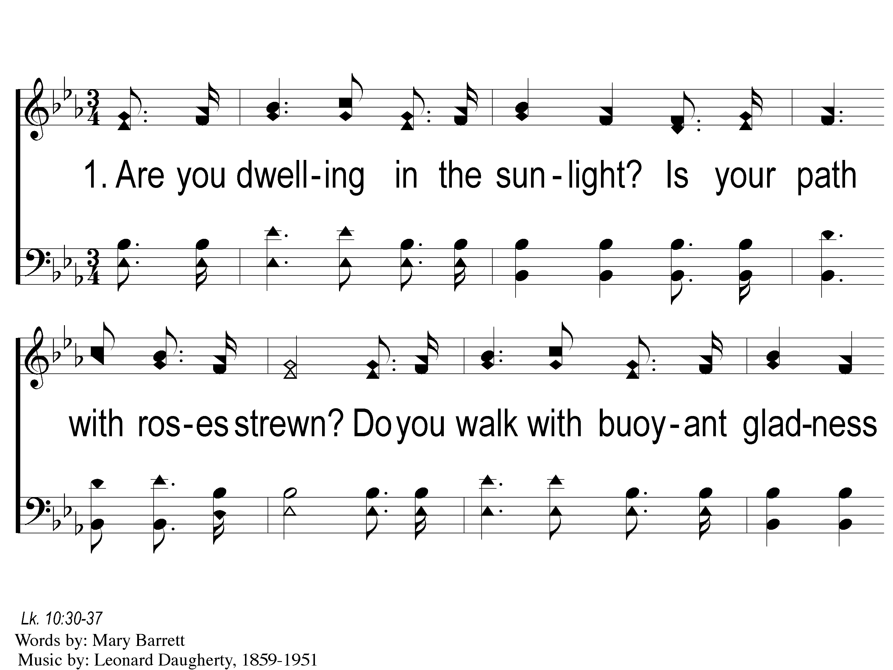
1-1 Down in the Valley
Down In The Valley
87
ePraise Hymn Presentation © 2005 Taylor Publications

Slide 2
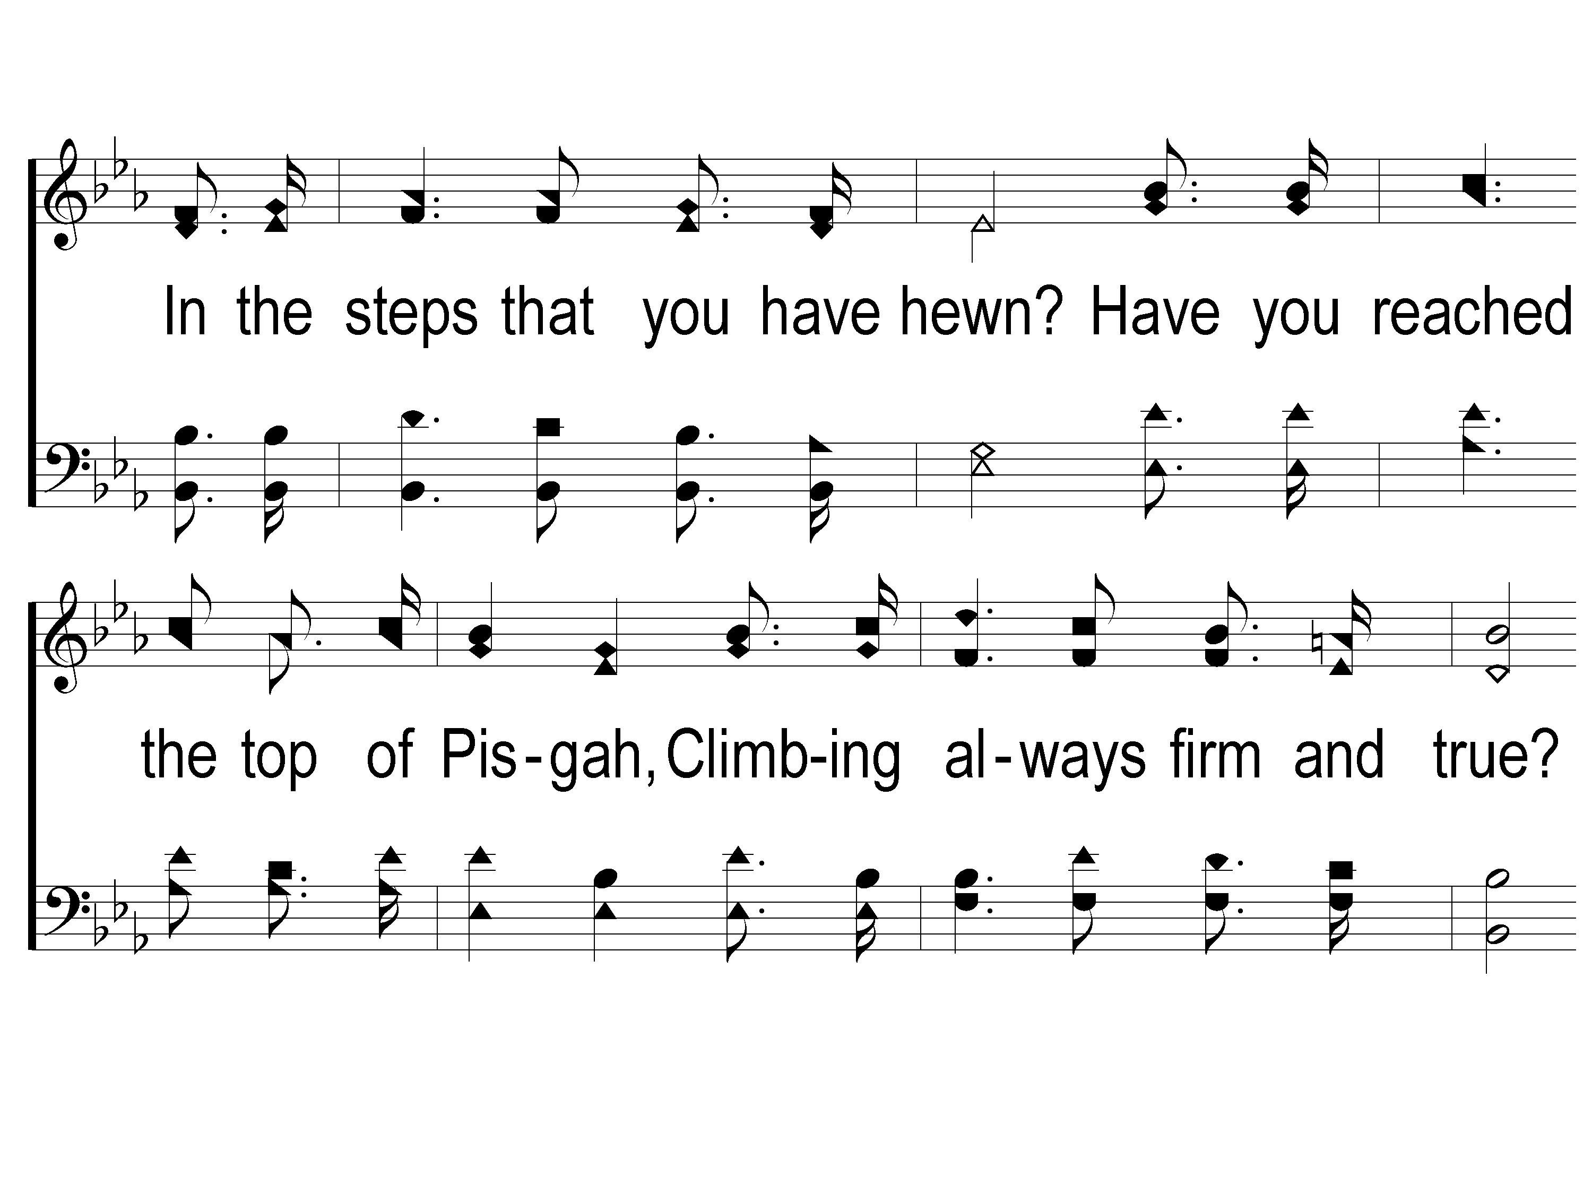
1-2 Down in the Valley
Down In The Valley
87
ePraise Hymn Presentation © 2005 Taylor Publications

Slide 3
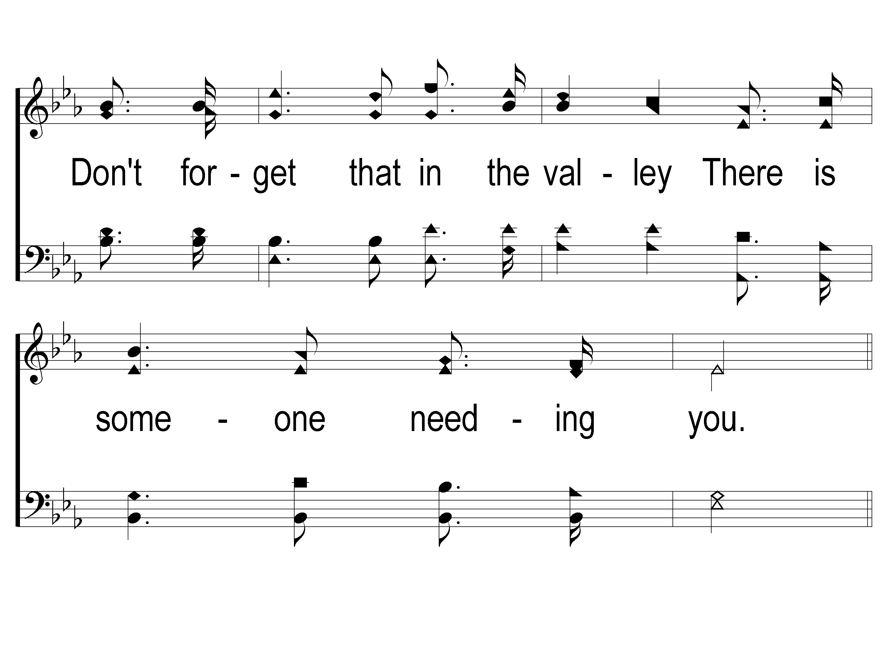
1-3 Down in the Valley
Down In The Valley
87
ePraise Hymn Presentation © 2005 Taylor Publications

Slide 4
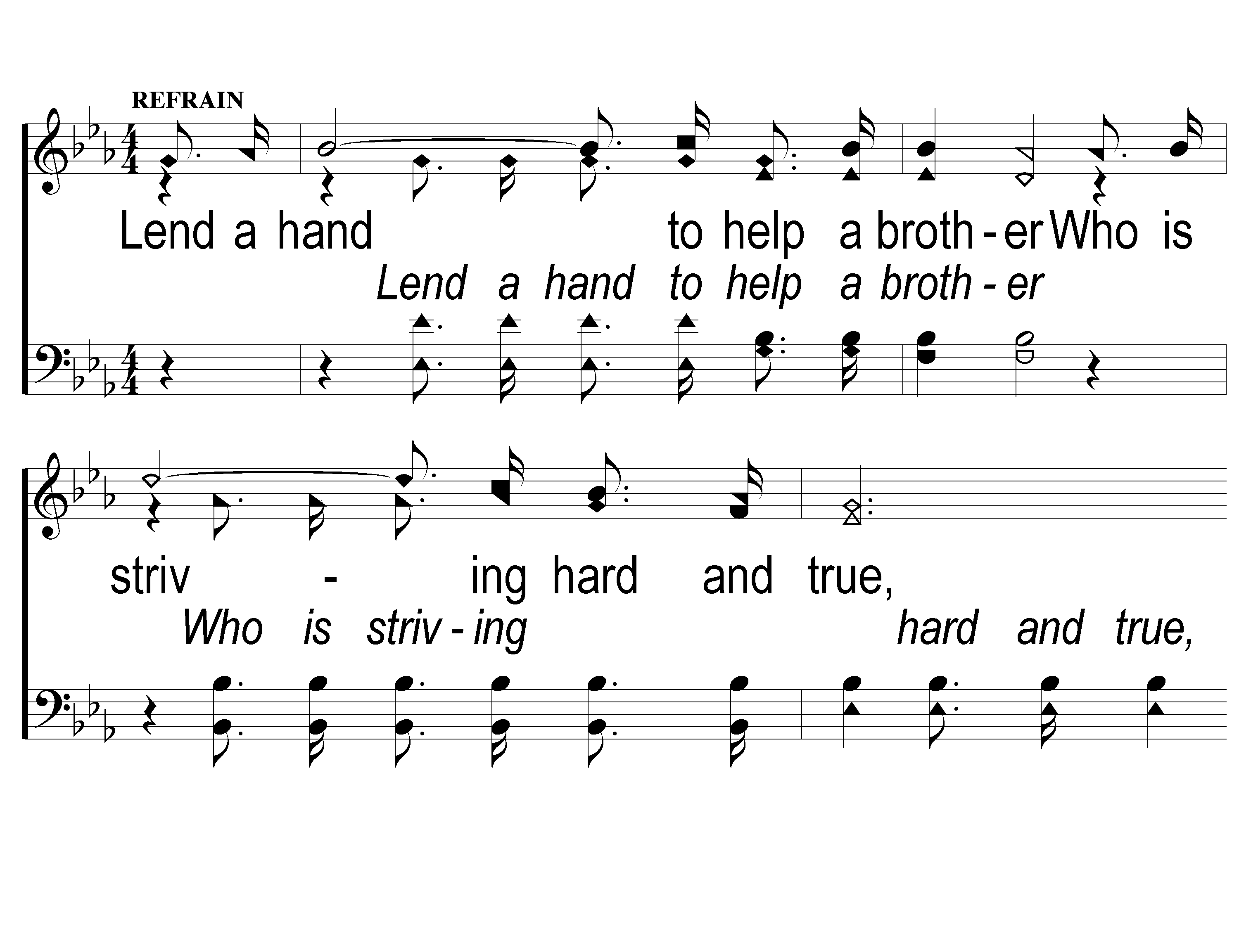
C-1 Down in the Valley
Down In The Valley
87
ePraise Hymn Presentation © 2005 Taylor Publications

Slide 5
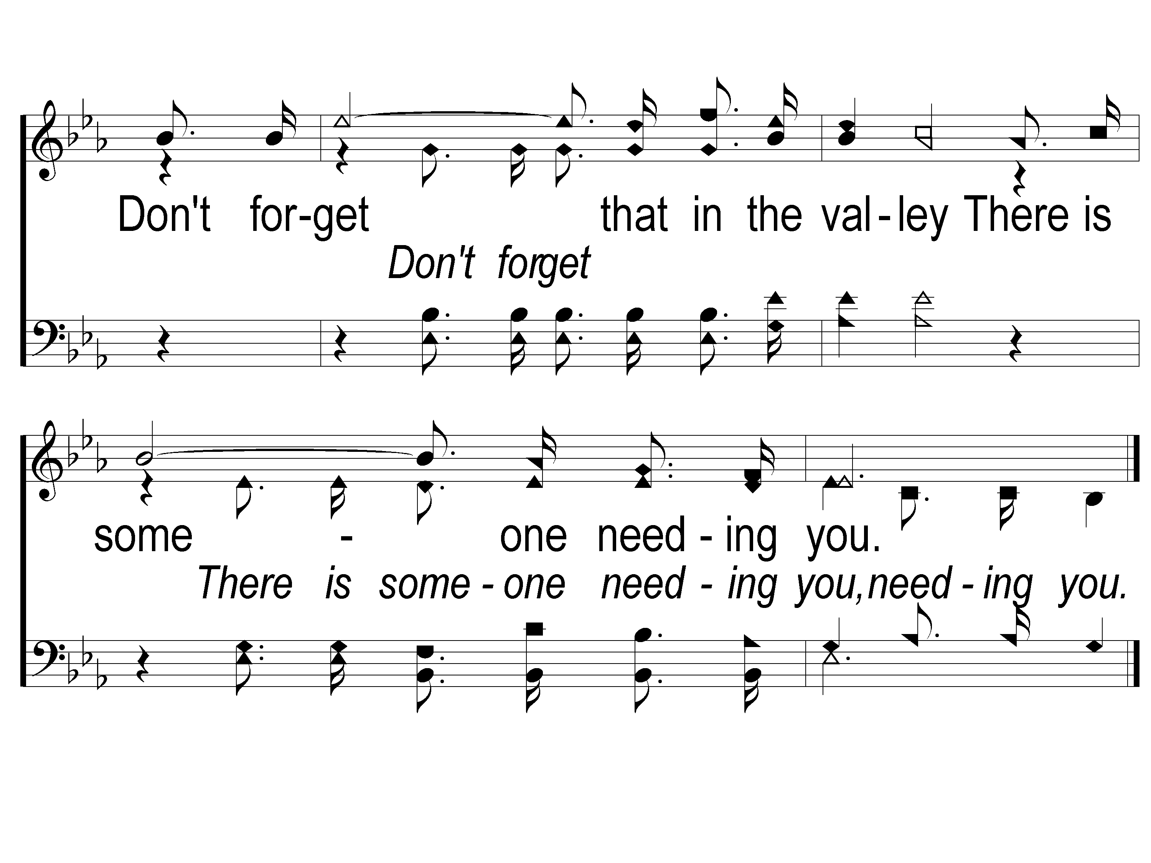
C-2 Down in the Valley
Down In The Valley
87
ePraise Hymn Presentation © 2005 Taylor Publications

Slide 6
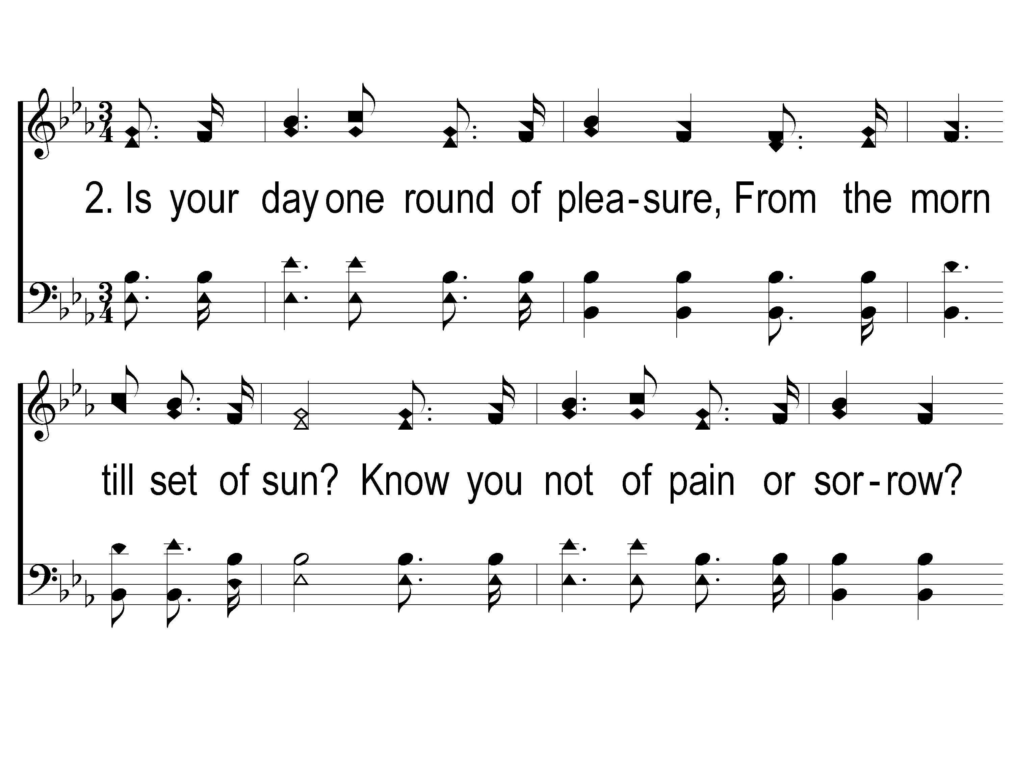
2-1 Down in the Valley
Down In The Valley
87
ePraise Hymn Presentation © 2005 Taylor Publications

Slide 7
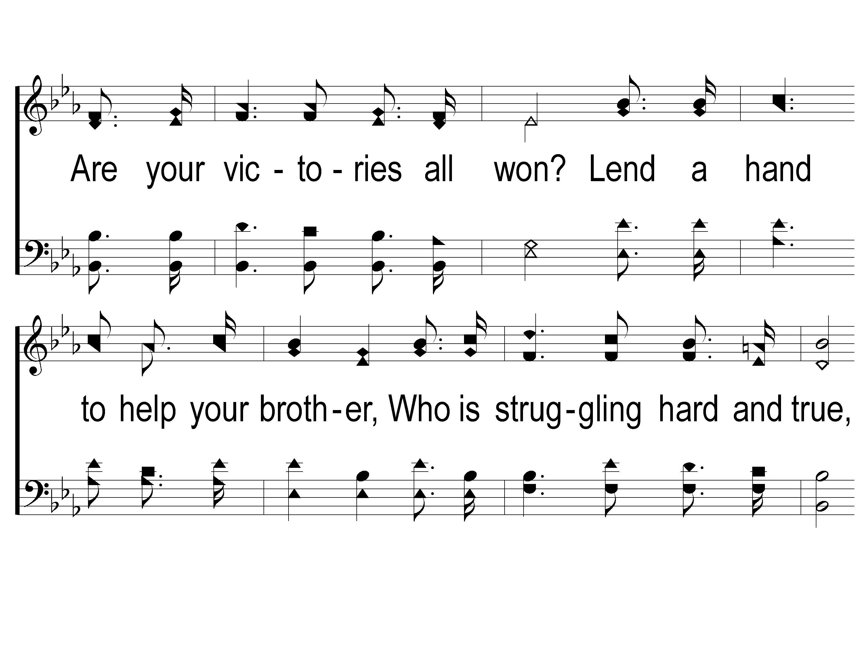
2-2 Down in the Valley
Down In The Valley
87
ePraise Hymn Presentation © 2005 Taylor Publications

Slide 8
2-3 Down in the Valley
Down In The Valley
87
ePraise Hymn Presentation © 2005 Taylor Publications

Slide 9
C-1 Down in the Valley
Down In The Valley
87
ePraise Hymn Presentation © 2005 Taylor Publications

Slide 10
C-2 Down in the Valley
Down In The Valley
87
ePraise Hymn Presentation © 2005 Taylor Publications

Slide 11
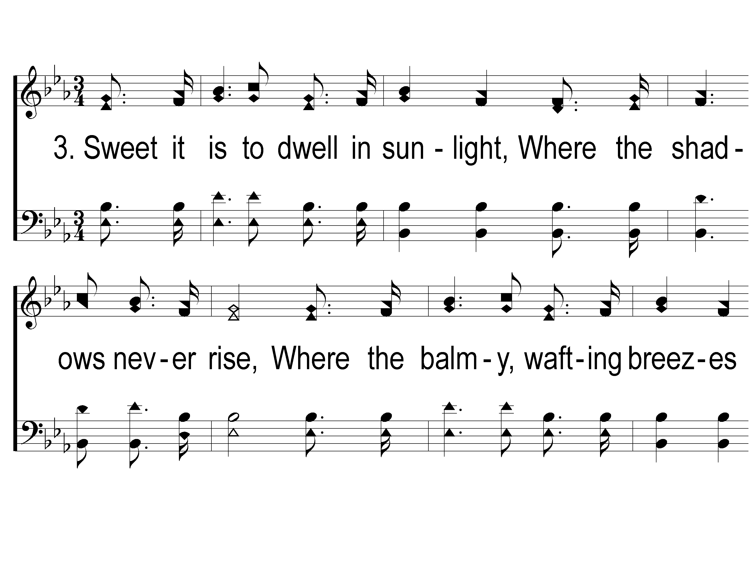
3-1 Down in the Valley
Down In The Valley
87
ePraise Hymn Presentation © 2005 Taylor Publications

Slide 12
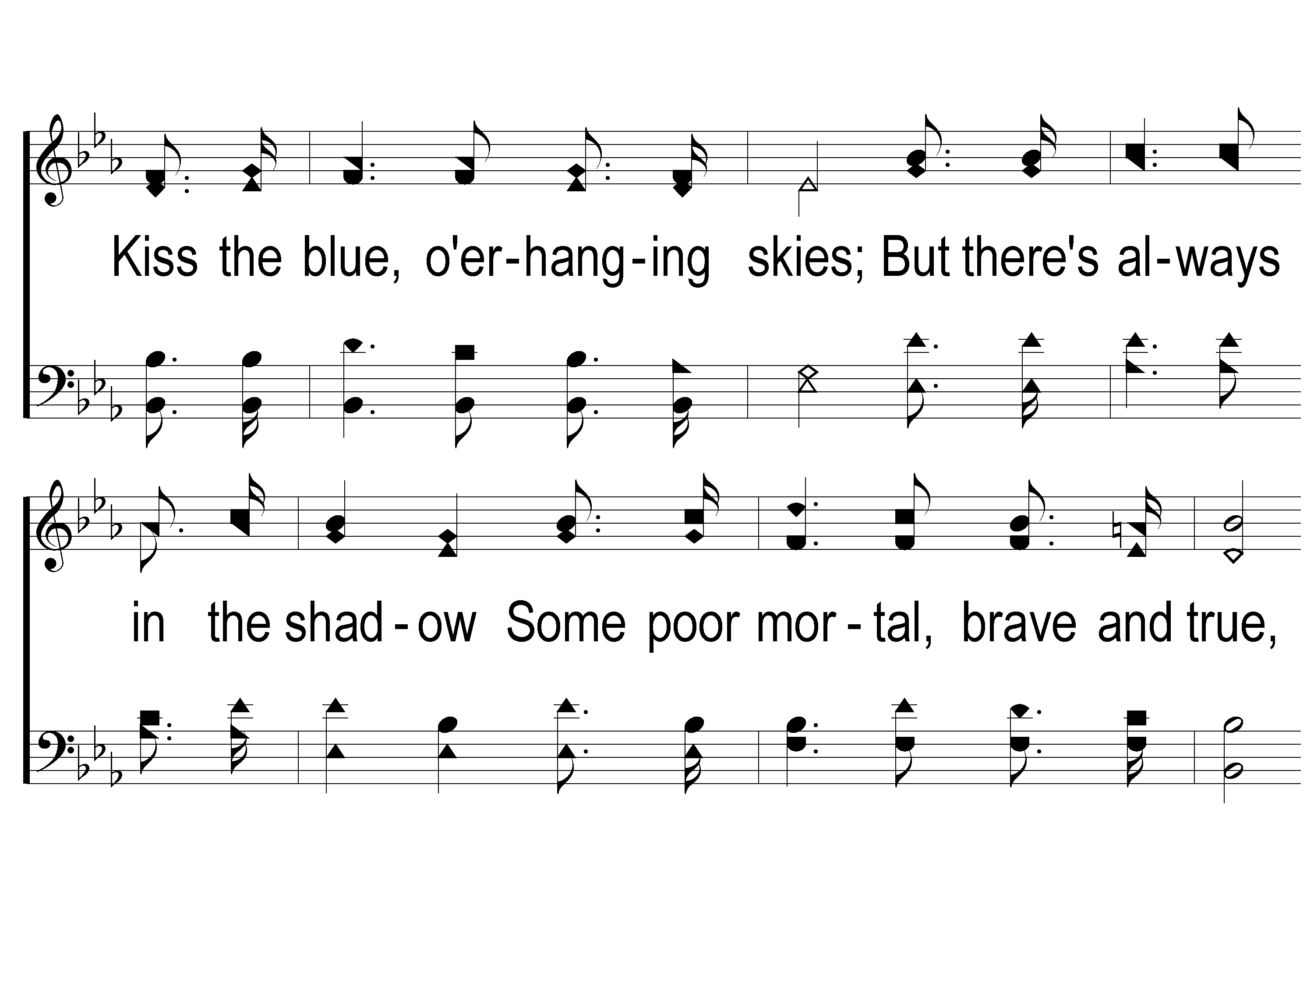
3-2 Down in the Valley
Down In The Valley
87
ePraise Hymn Presentation © 2005 Taylor Publications

Slide 13
3-3 Down in the Valley
Down In The Valley
87
ePraise Hymn Presentation © 2005 Taylor Publications

Slide 14
C-1 Down in the Valley
Down In The Valley
87
ePraise Hymn Presentation © 2005 Taylor Publications

Slide 15
C-2 Down in the Valley
Down In The Valley
87
ePraise Hymn Presentation © 2005 Taylor Publications

